Slide 1


Exploring Hacker News Posts: Analysis & Insights
This presentation delves into a comprehensive analysis of Hacker News posts, exploring trends in post popularity, user engagement, and content types. We'll examine a dataset of 3.5 million entries, uncovering valuable insights and actionable recommendations for enhancing the platform's user experience and content strategy.
by Krishnali lahane

Slide 2

Introduction & Methodology
1
Objective
2
Data Overview
3
Methodology
The primary objective is to analyze trends in post popularity, user engagement, and content types on Hacker News.
The dataset comprises 3.5 million entries, encompassing post titles, scores, comments, post types, and timestamps.
Our methodology involves data cleaning, text analysis, and temporal analysis to extract meaningful insights.

Slide 3
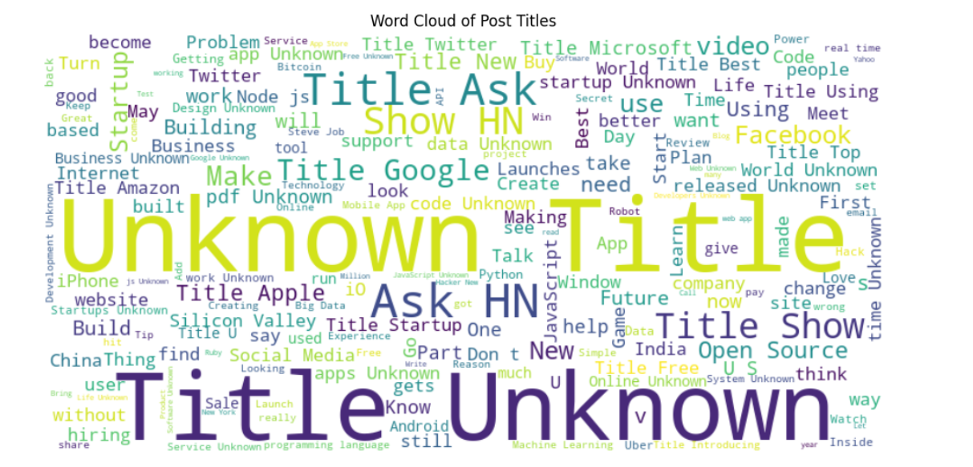
Word Cloud of Post Titles
Key Findings
The word cloud reveals common themes and trending topics in post titles.

Slide 4
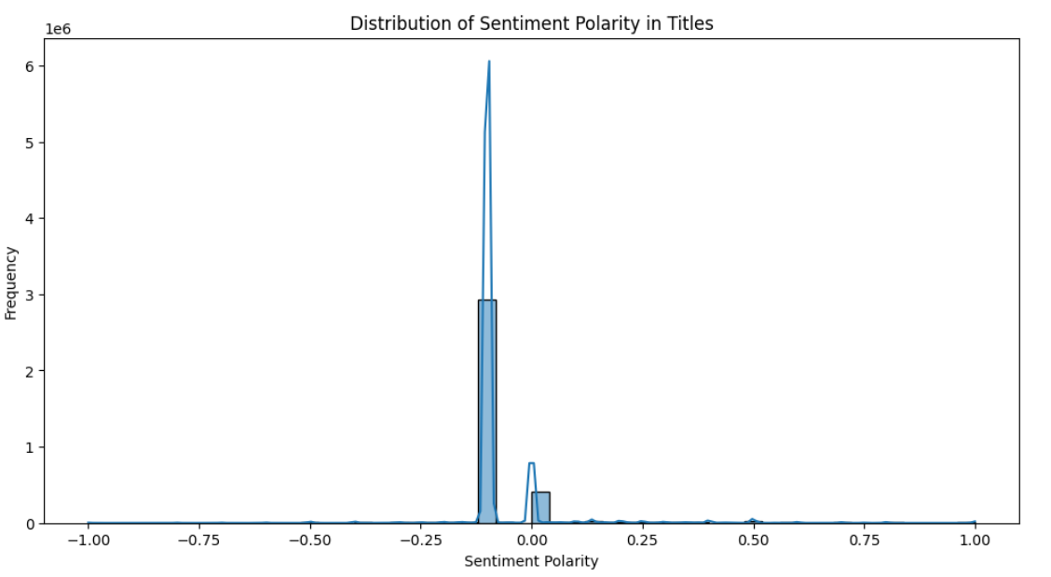
Sentiment Analysis of Post Titles
Key Findings
Sentiment analysis reveals that most post titles exhibit a neutral sentiment, with a sharp peak around zero.

Slide 5
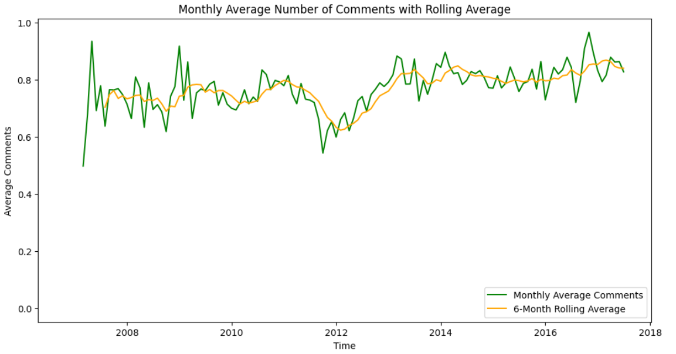

Temporal Trends - Monthly Average Comments
1
2
Fluctuations
Rolling Average
The line chart reveals noticeable monthly variations in comment counts, indicating fluctuations in user engagement.
The 6-month rolling average highlights a relatively stable long-term trend with periodic spikes, suggesting consistent overall engagement despite short-term fluctuations.

Slide 6
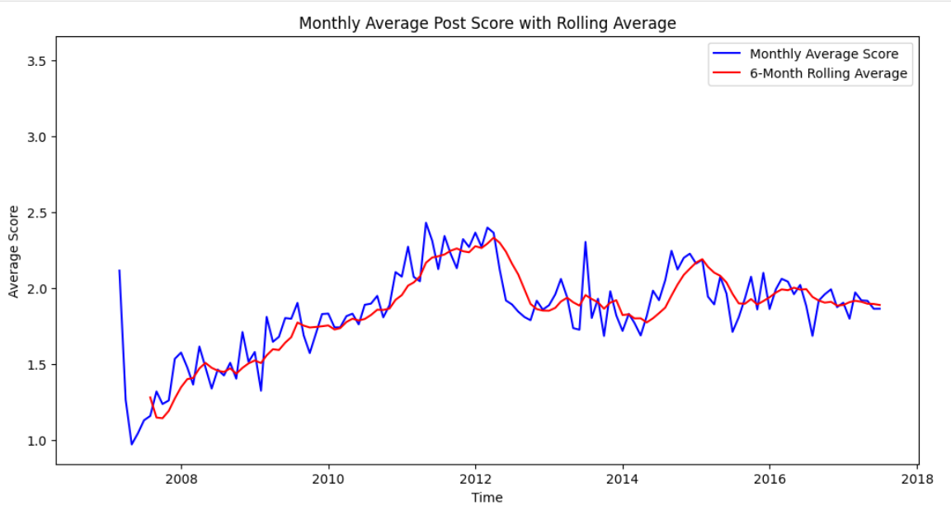

Temporal Trends - Monthly Average Post Scores
1
Initial Upward Trend
The line chart shows an initial upward trend in post scores, indicating increasing post quality or engagement.
2
Subsequent Stabilization
Post scores stabilized after an initial rise, with some decline observed, suggesting that post quality or engagement levels may have plateaued.

Slide 7
Distribution of Post Types
Prevalence of Comments
Stories
Minimal Other Types
Comments are the most common type of post, indicating high user engagement in discussions.
Stories are the second most frequent post type, suggesting user interest in shared content.
Polls, jobs, and polls are less common, indicating potential for increasing engagement in less utilized post types.

Slide 8

Insights & Recommendations
Key Insights
Neutral and descriptive titles are more common, trending topics include tech giants and startups, and user interaction varies but shows a stable trend.
Recommendations
Encourage more descriptive and engaging titles, create content around trending tech topics, increase the frequency of "Ask HN" and "Show HN" posts, and explore ways to boost engagement in less common post types.

Slide 9

Key Challenges & Limitations
Challenges
Mitigation Strategies
Missing Data
Use statistical methods or additional sources to fill in missing values.
Data Quality Issues
Implement guidelines to reduce the occurrence of generic or placeholder titles.
Temporal Variations
Consider external factors that might affect engagement patterns and trends.

Slide 10




Next Steps & Future Work
Further Analysis
Investigate more granular metrics such as user demographics, post timing, and interaction depth, and conduct long-term studies to understand evolving trends and the impact of platform changes.
Actionable Steps
Improve data quality by addressing missing values and ensuring comprehensive title metadata, gather user feedback to understand preferences and improve content strategies, and explore new features or enhancements based on user engagement trends and content types.
Collaborations
Work with marketing, content creation, and data science teams to implement recommendations and monitor effectiveness, and engage with the user community to encourage participation and gather insights on content preferences.

